Slide 1

Second Fabrication Cycle
Alec Fredriksson
Shannon Lai
Simond Liu
Wilson Lam

Slide 2
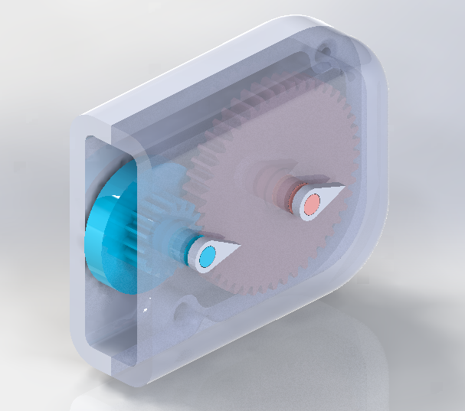

Pocket Ruler Rev B
Handy measuring device for everyday applications
Compact and lightweight design
Measurements of up to 1 foot
Wheel
Dial Indicators

Slide 3
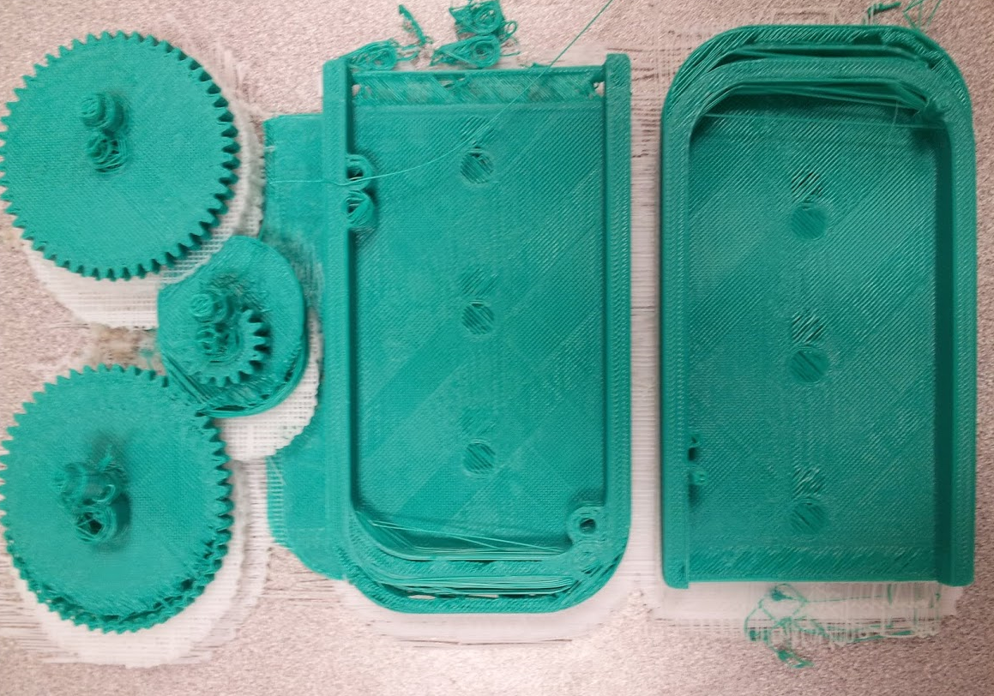
Design modifications
Reduced component sizes by simplifying design.
Increased tolerances between mated components
Increased feature sizes (i.e. fillets, chamfers, etc.)
First Fabrication Results
Proposed Design Modifications

Slide 4
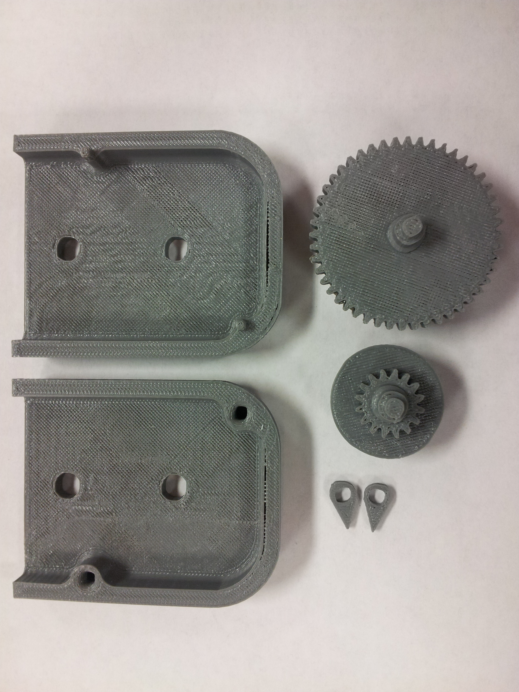
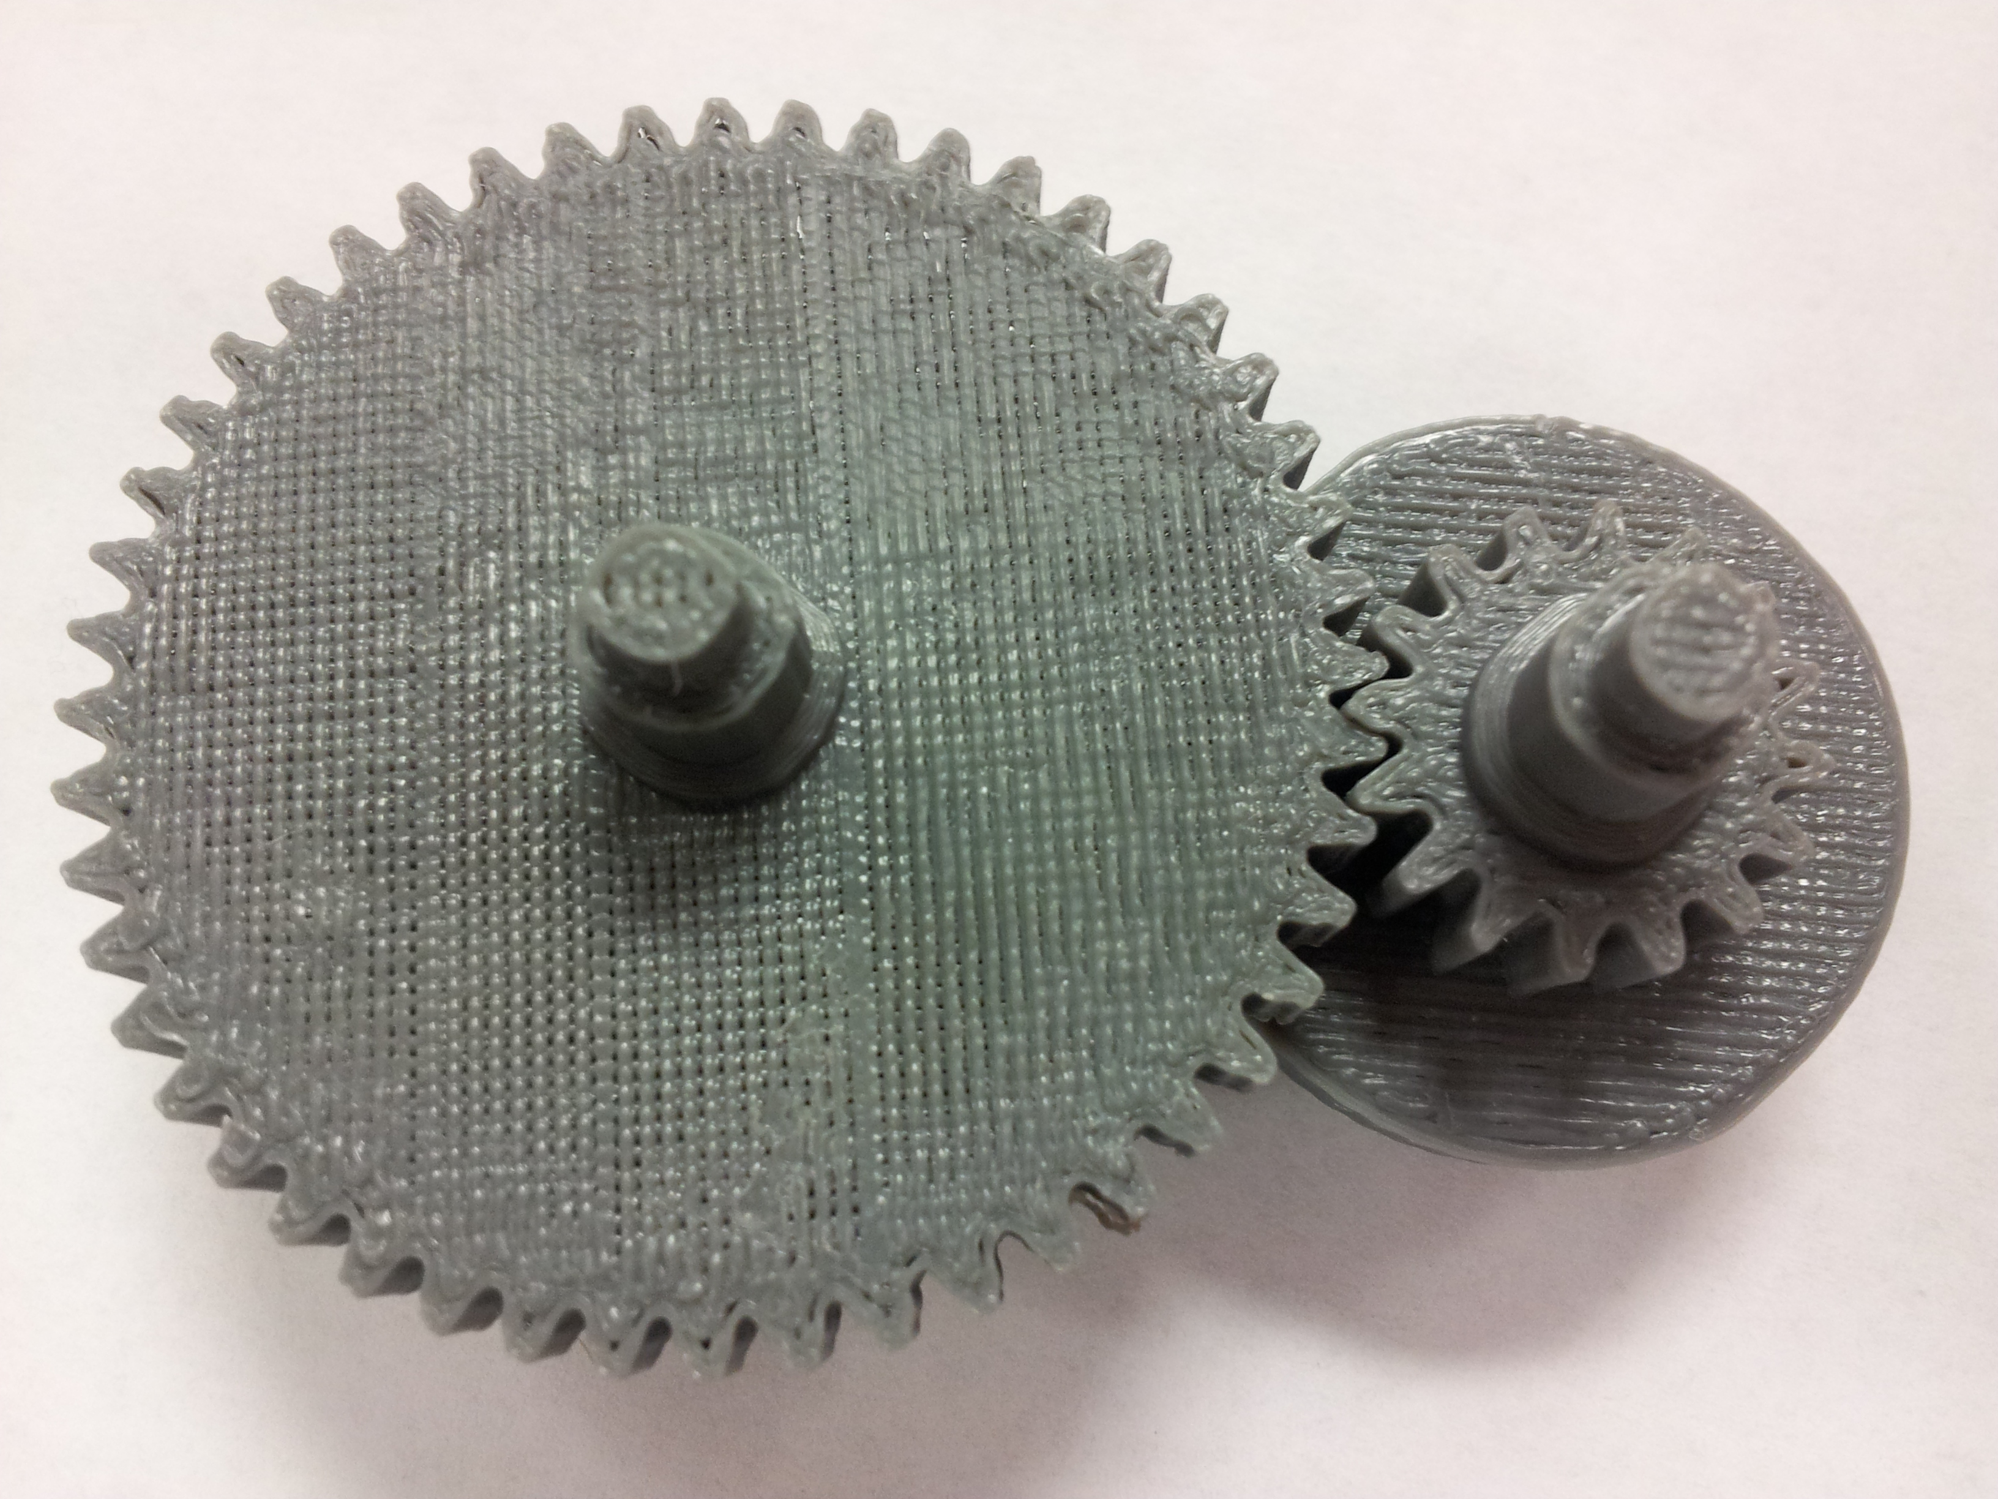
Cycle #2 Printing Results
No mis-alignment issues
Fairly accurate results
Gears mesh correctly and parts align during assembly

Slide 5
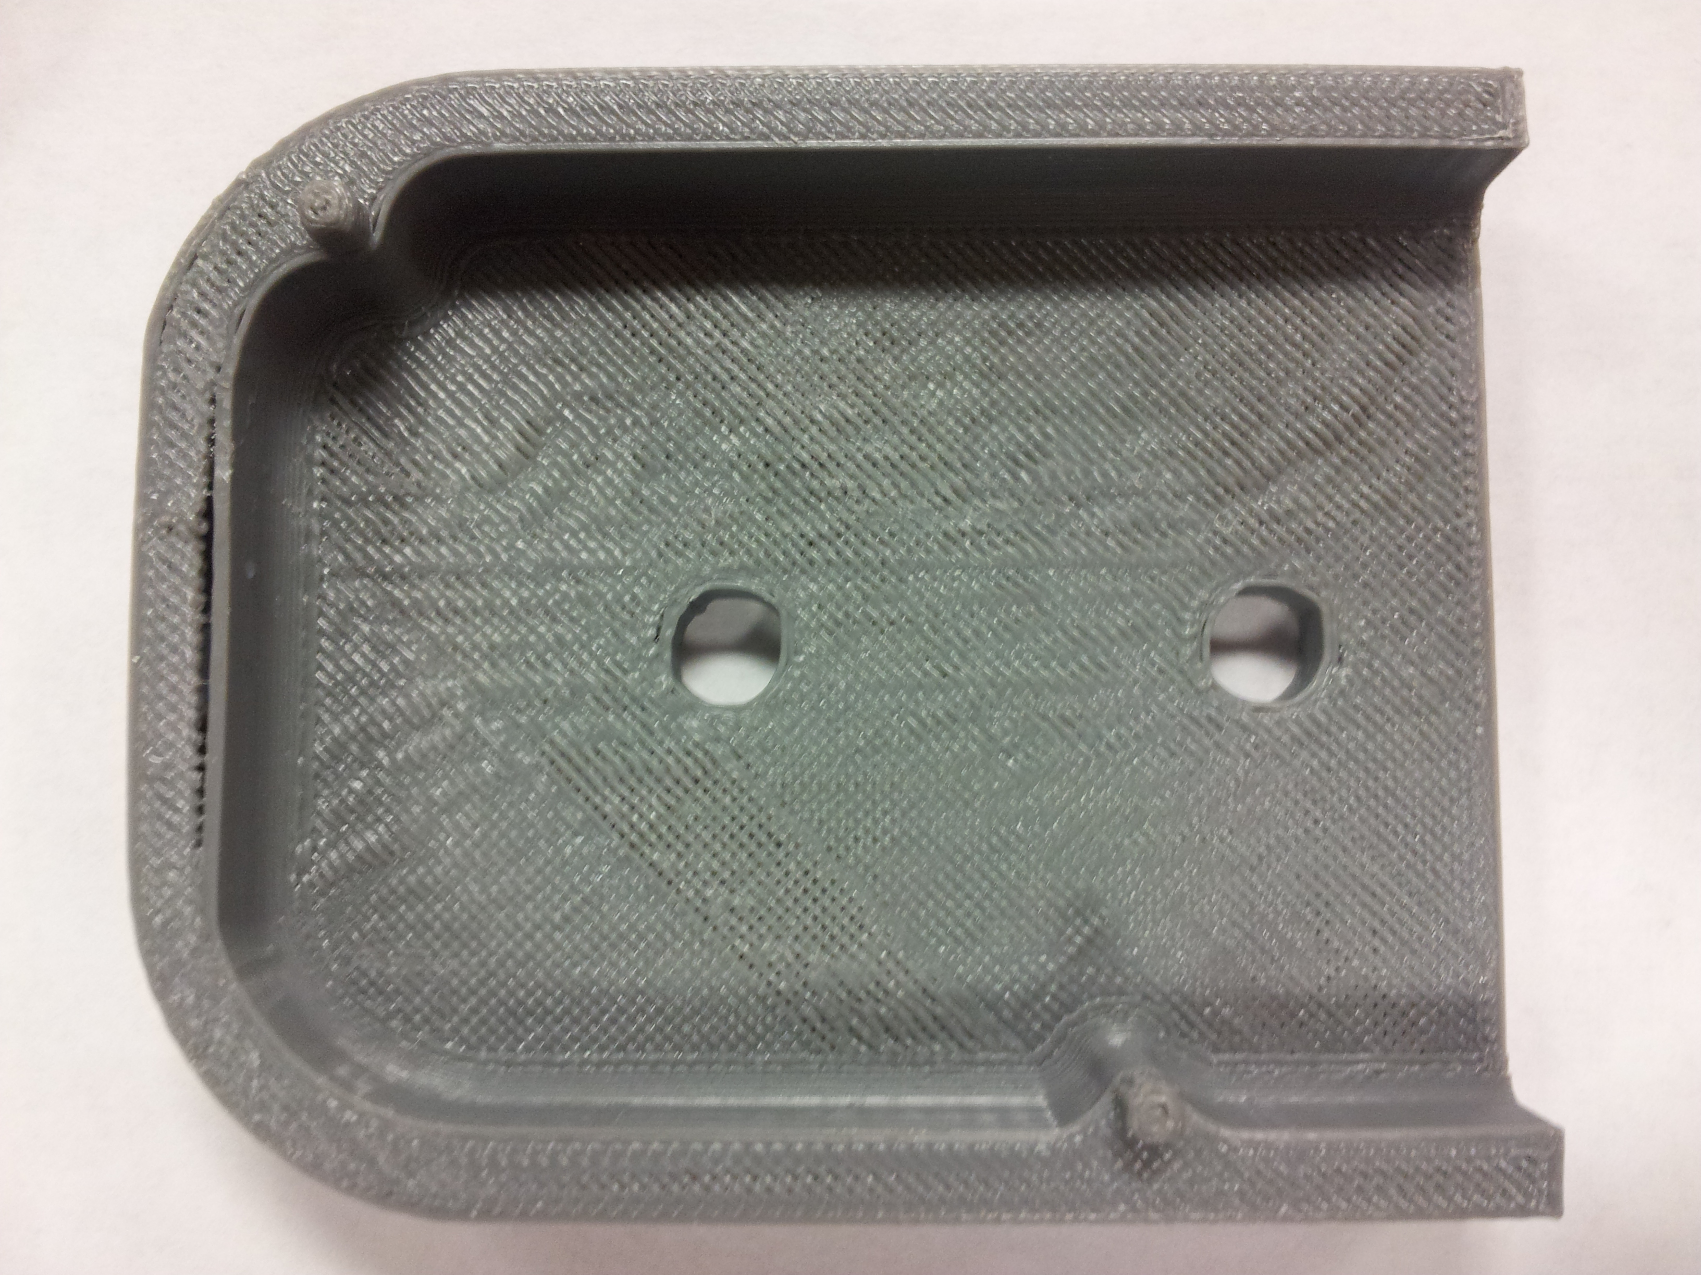
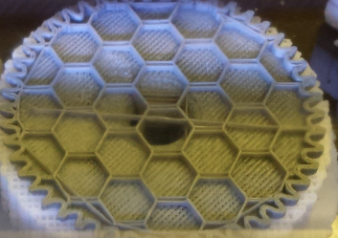
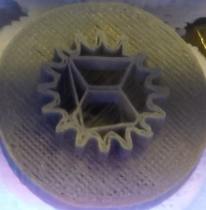
Cycle #2 Printing Results
Non-circular hole and shaft diameters
Hollow interior. Structurally weak components.
Non-circular
holes
Hollow cross sections

Slide 6
Demonstration

